Slide 1

INDUSTRIAL TRAINING REPORT ON PYTHON
AT
CETPA INFOTECH PRIVATE LIMITED
NOIDA
COMPUTER SCIENCE & ENGINEERING
[1661] GOVERNMENT POLYTECHNIC MAWANA KHURD MEERUT
SUBMITTED BY SUBMITTED TO
MOHD SUHAIL MANU AGGRAWAL
ENROLLMENT NO. - E20166135500033

Slide 2
TABLE OF CONTENT
What is Python
History of Python
Version of Python
Keyword of Python
Python Instrallation
Oops :-
6.1 Class
6.2 Object
6.3 Abstract
6.4 Inheritance
6.5 Polymorphism
6.6 Encapsulation

Slide 3
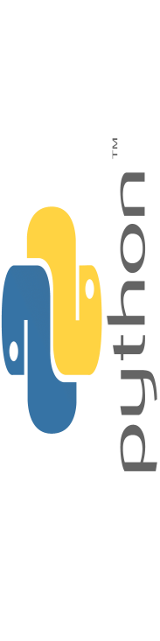
k

Slide 4
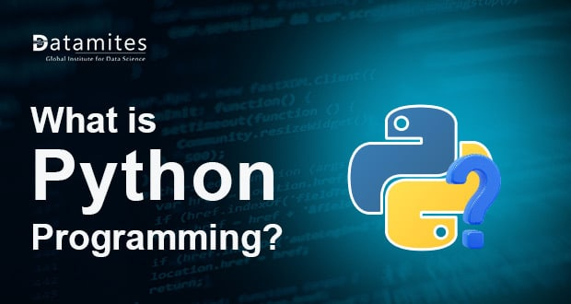

Slide 5
1. WHAT IS PYTHON PROGRAMMING
Python has a simple syntax similar to the English language.
Python has syntax that allows developers to write programs
With fewer lines than some other programming language.
Python runs on an interpreter system , meaning that code can
Be executed as soon as it is written. This means that
Prototyping can be very quick.

Slide 6
2. HISTORY OF PYTHON
Python was conceived in the late 1980, and its implementation
Was started in december 1989 by guido van rossum at CWI in
The netherlands as a successor to the ABC language(itself
Inspired by SELT ) capable of exception handling and interfacing
With the amoeba operating system. Van rossum is python’s
Principle author , and his continuing central role in deciding
the direction of python is reflected in the title given to him by
The python community, benevolent dictator for life (BDFL)

Slide 7
3. VERSION OF PYTHON A list of python version with its released date is given below.
Python Version | Released Date
Python 1.0 | January 1994
Python 1.5 | December 31, 1997
Python 1.6 | September 5, 2000
Python 2.0 | October 16, 2000
Python 2.1 | April 17, 2001
Python 2.2 | December 21, 2001
Python 2.3 | July 29, 2003
Python 2.4 | November 30, 2004
Python 2.5 | September 19,2006
Python 2.6 | October 1, 2008

Slide 8
Version
Python 2.7 | July 3, 2010
Python 3.0 | December 3, 2008
Python 3.1 | June 27, 2009
Python 3.2 | February 20, 2011
Python 3.3 | September 29, 2012
Python 3.4 | March 16, 2014
Python 3.5 | September 16, 2015
Python 3.6 | December 23, 2016
Python 3.7 | June 27, 2018

Slide 9
4. KEYWORD OF PYTHON Python keyword are special reserved words which convey a special meaning to the compile/interpreter. Each keyword have a special meaning and a special operation. These keywords can’t be used as variable. Following is the list of python keywords.
True | False | None | and | as
assert | def | class | continue | break
else | finally | elif | del | except
global | for | If | from | import
raise | try | or | return | pass
nonlocal | in | not | is | lambda

Slide 10
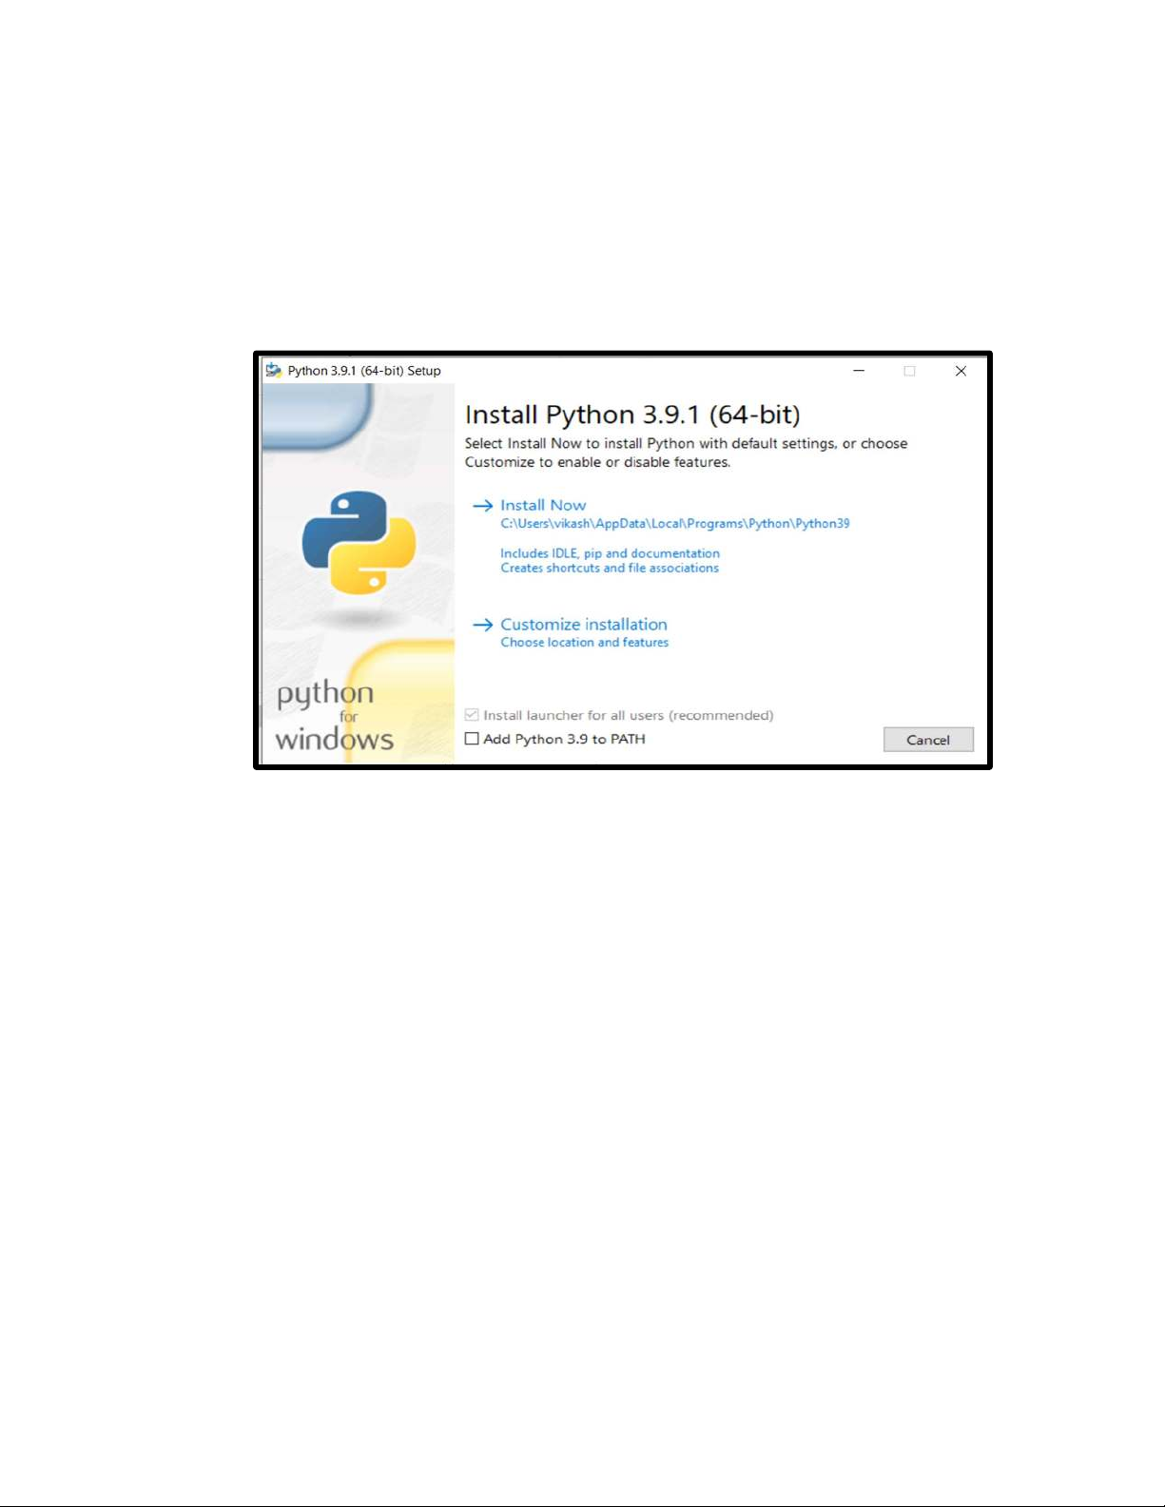

Slide 12
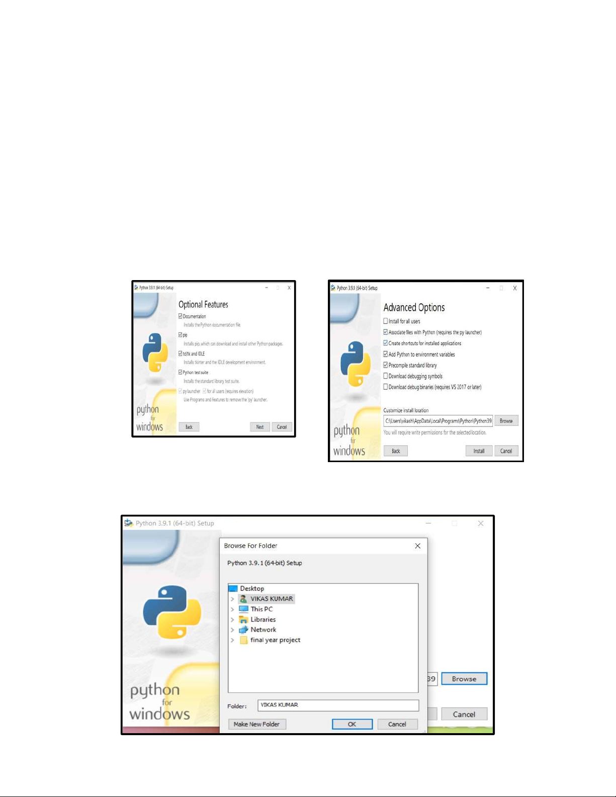

Slide 13
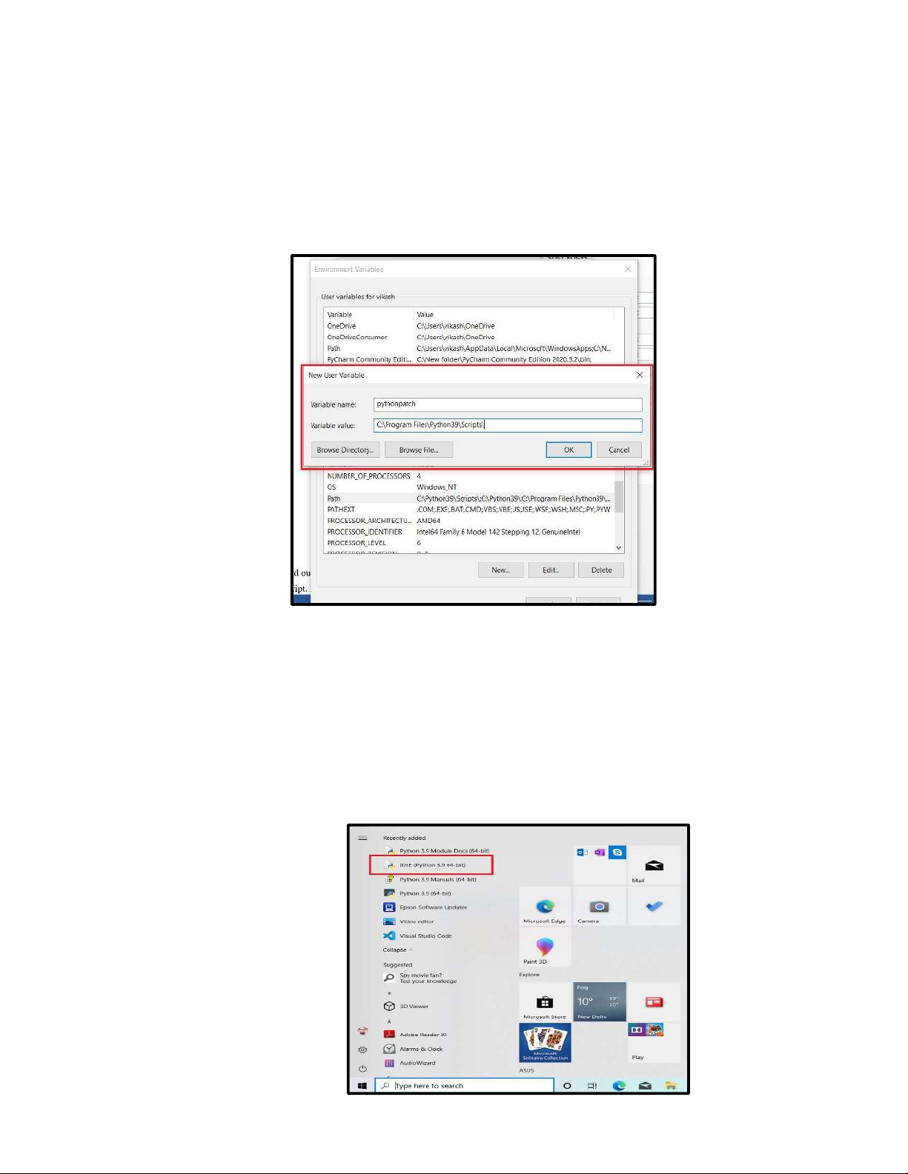

Slide 14
6. OOPS(Object-Oriented Programming System) 6.1 CLASS
The class is a user -defined data structure that binds
the data members and method into a single unit. Class is a
Blueprint or code template for object creation.

Slide 15
6.2 OBJECT
An object is an instance of a class. It is a collection of attributes
(variables) and methods. We use the object of a class to perform
actions.

Slide 16
6.3 ABSTRACTION
Abstraction is one of the most important features of object-
Oriented programming . It is used to hide the background
Details or any unnecessary implementation.

Slide 17
6.4 INHERITANCE
Inheritance is a way of creating a new class for using details of
An existing class without modifying it. The newly formed class is
A derived class . Similarly, the existing class is a base class.

Slide 18
6.5 POLYMORPHISM
Polymorphism is another important concept of object oriented
programming. It simply means more than one form.
That is the same entity (method or operator or object) can
perform different operations in different scenarios.

Slide 19
6.6 ENCAPSULATION
Encapsulation is one of the key features of object-oriented
programming. Encapsulation refers to the bundling of
attributes and methods inside a single class.
It prevents outer classes from accessing and changing attributes
and methods of a class. This also helps to achieve data hiding.

Slide 20
THANK YOU

